Slide 1
RF Retrofit Kit installation guide
@copyright 2010 Transcell Technology, Inc.

Slide 2
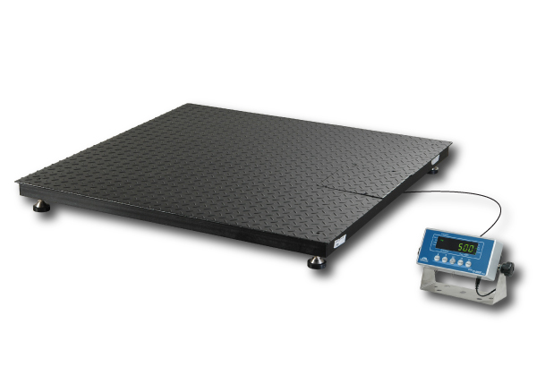
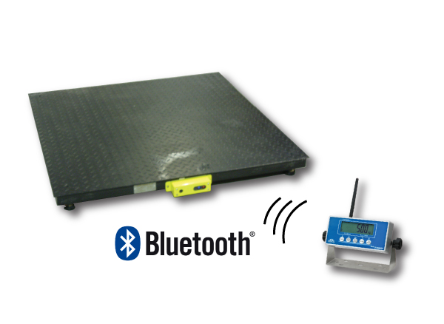
Concept:
The idea is to take any regular floor scale (already installed in the field) and adapt it (using our conversion kit) into a wireless scale. It is not restricted to floor scales but there is a huge population of this type of scale in the field over many years.
Old wired floor scale
Retrofitted floor scale with wireless technology

Slide 3
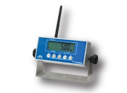
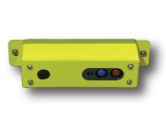
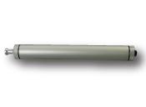
What you get:
You get an RF weighing module, an RF digital indicator, a battery holder and a protective metal bracket. The RF components utilize reliable Bluetooth technology.
Battery holder
RF weighing module
RF digital indicator
(also available in stainless steel version)

Slide 4
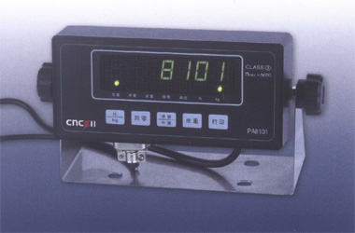
Installation: Step 1
Throw away the current display unit (indicator) - but keep the rest of the scale!

Slide 5
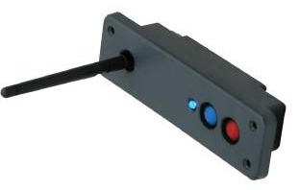
Installation: Step 2
Mount the RF weighing module into the protective metal bracket!
RF weighing module
RF weighing module installed to metal bracket

Slide 6
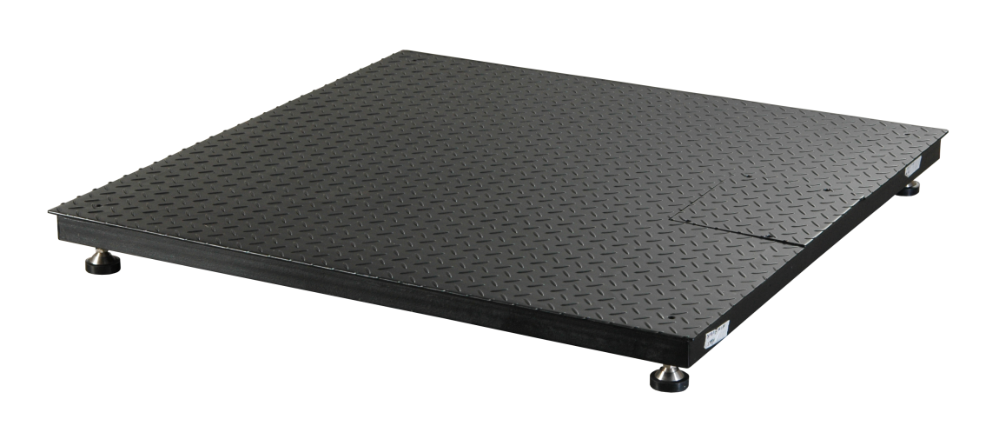
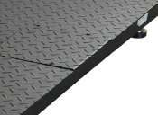
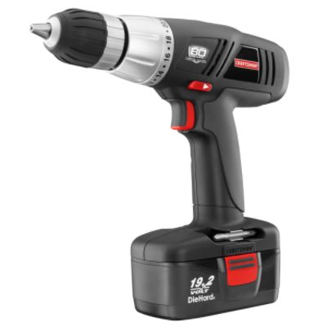
Installation: Step 3
Drill two mounting holes in the side of the floor scale adjacent to the junction box compartment.
Location junction box
Drill 2x holes for the metal bracket

Slide 7
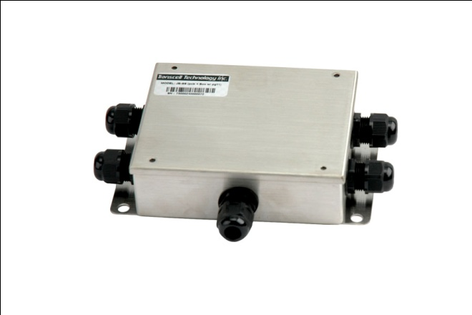
Installation: Step 4
Connect the output from the junction box to the load cell terminal on the RF weighing module.
Connect output wire (originally connected to old wired indicator) to the new weigh module
Load cells are connected to the junction box via wires
Weigh module

Slide 8
Installation: Step 5
Connect the leads from the battery holder to the appropriate terminal on the RF weighing module.
Power cable
Battery holder
Weigh module

Slide 9
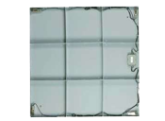
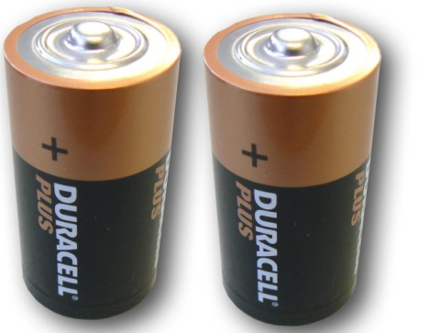
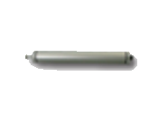
Installation: Step 6
Install the batteries (4-C) into the battery holder and stow in the junction box compartment
Underside of floor scale
Add 4 C cell Batteries in the battery holder
Open up the junction box and stow the battery pack inside. If there are no room, install the unit next to the j-box

Slide 10
Installation: Step 7
Using supplied hardware, mount the RF weighing module to the side of the floor scale
Underside of floor scale
Install the weigh module on the junction box side via the screw holes from step 3.
J-box

Slide 11
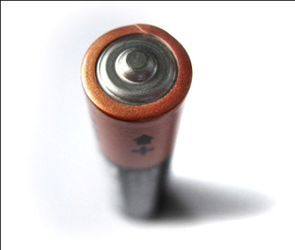
Installation: Step 9
Install batteries into digital indicator
Configure indicator to floor scale and perform a digital calibration
*Please refer to the user manual to configure and to correctly calibrate the indicator.

Slide 12
Installation: Step 8
You now have properly installed and configure your new wireless scale.
Enjoy!!!

Slide 13
Thank you!
@copyright 2010 Transcell Technology, Inc.

